Slide 1
RAINWATER HARVESTING
By: Shreyas R

Slide 2
What is Rainwater harvesting and why is it important?
Rainwater harvesting is the simple process or technology used to conserve Rainwater by collecting and purifying of Rainwater for later use.
Advantages:
You’ll have water when you need it
It is superb for irrigation
It’s super easy to install
It is a more sustainable practice

Slide 3
Electricity from Rain Water:
Yes, you read it right, we can generate electricity from rainwater using small mechanisms.
In Bengaluru the average rainfall per hour=0.3cm
A regular house:
Height= 6.2 m (2 floor)
Area = 1200 sq.ft (111 sq. m)
Water flow rate =0.1 L/s
Power produced = 6 Watt
Output Power(50% efficiency motor)=3 watt
An apartment:
Height= 30 m (10 floor)
Area = 5000 sq.ft (460 sq. m)
Water flow rate =0.4 L/s
Power produced = 30Watt
Output Power(50% efficiency motor)=15 watt

Slide 4
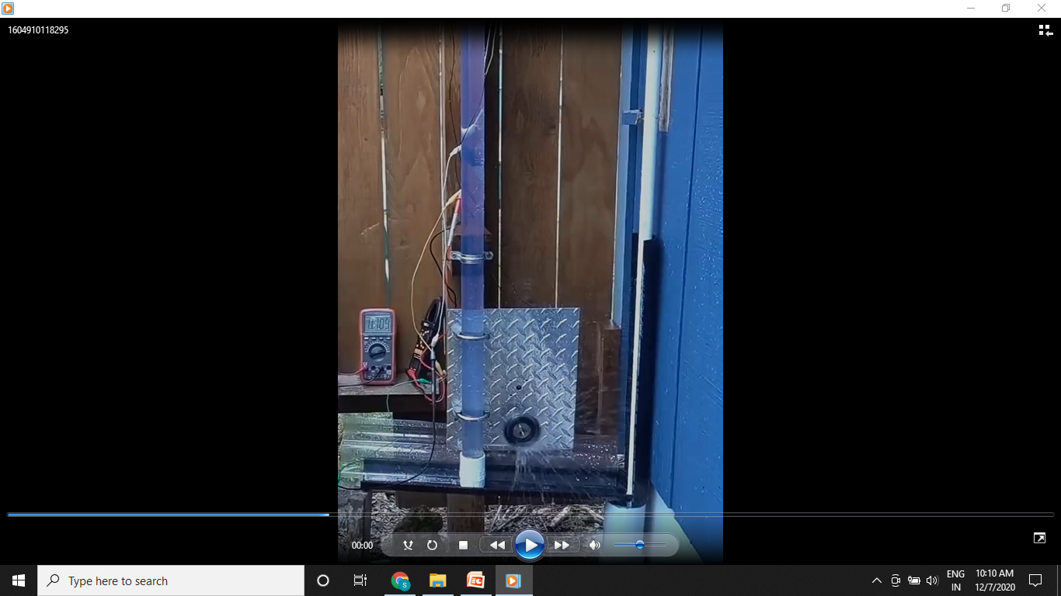

Slide 5
This method can be easily installed in any rain water harvesting system already built. It is also cost effective.
So for an apartment we can generate up to 15 watt, which is enough to charge a Smartphone and a light up a huge room.
This may not be sufficient, with advanced technologies and precised generators we can generate even higher amount of energy.

Slide 6
Recharge pits:
Recharge pits are closed well like structures, which is covered by filling the stones, after digging the land to make a pit.
The pit, if aimed for recharging the borewell, must be constructed near the borewell, as close as possible.

Slide 7
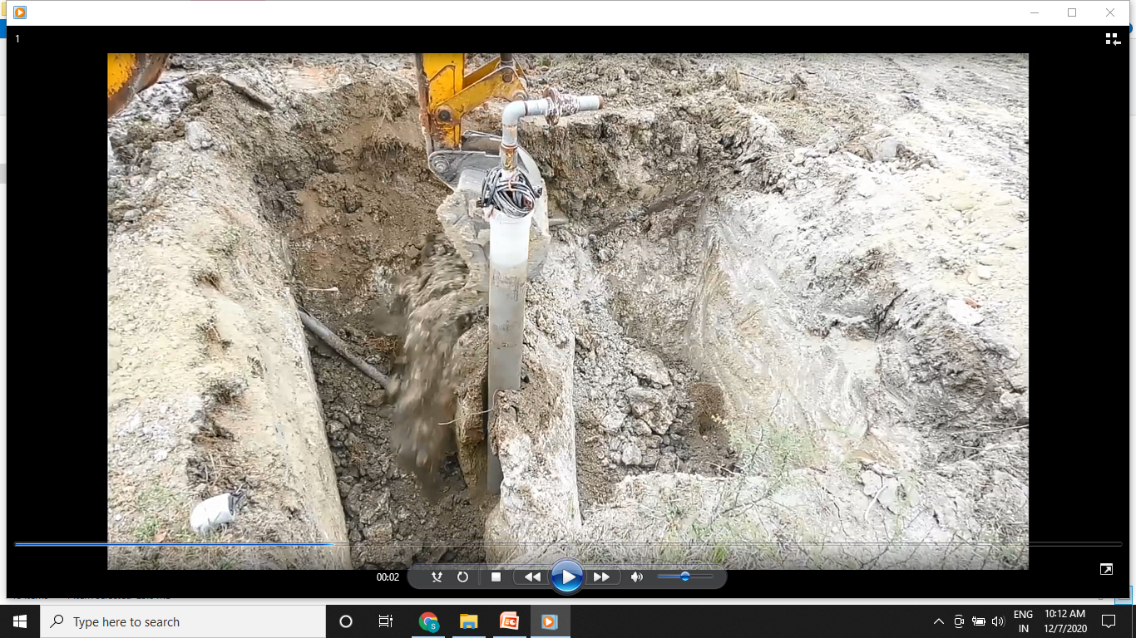
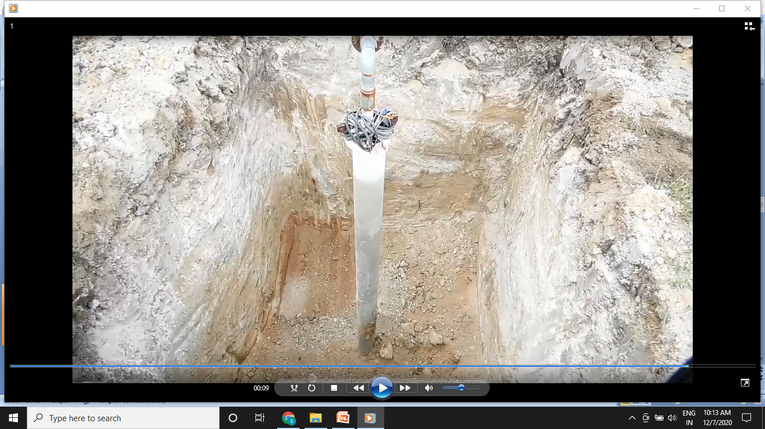
Steps For building A recharge Pit:
1)Digging A hole near the borewell:

Slide 8
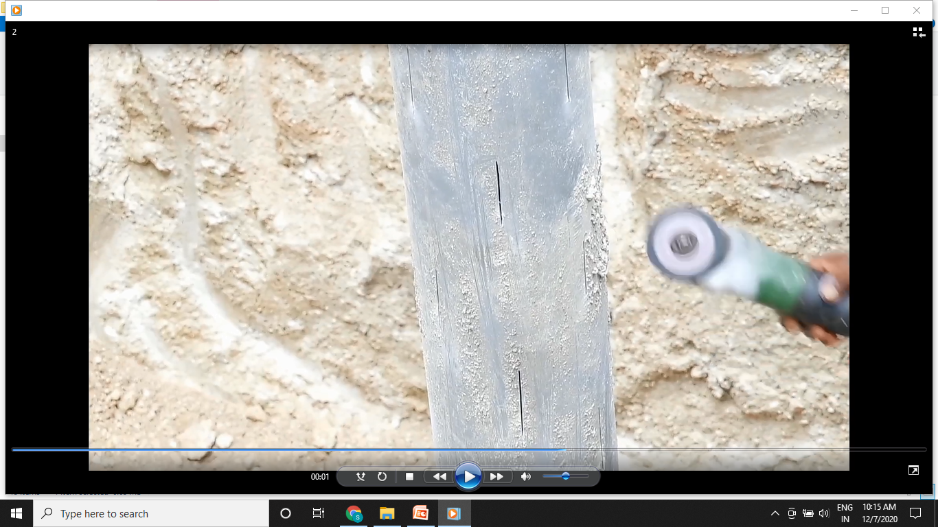
2)Making slit in the casting pipe for water seepage:

Slide 9
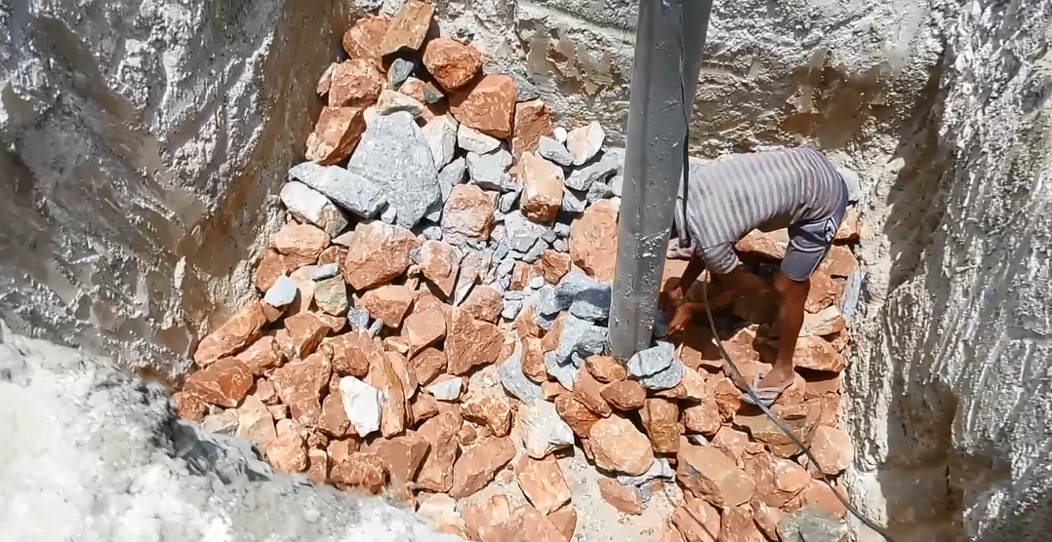
3)Filling the bottom half of the pit with large stone:

Slide 10
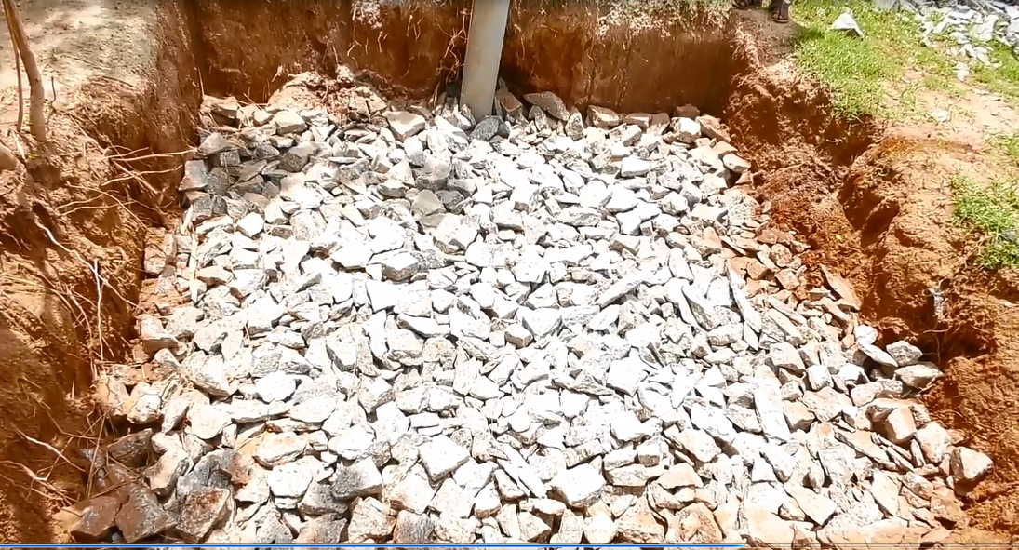
4)Filling the next quarter of the pit with small stones:

Slide 11
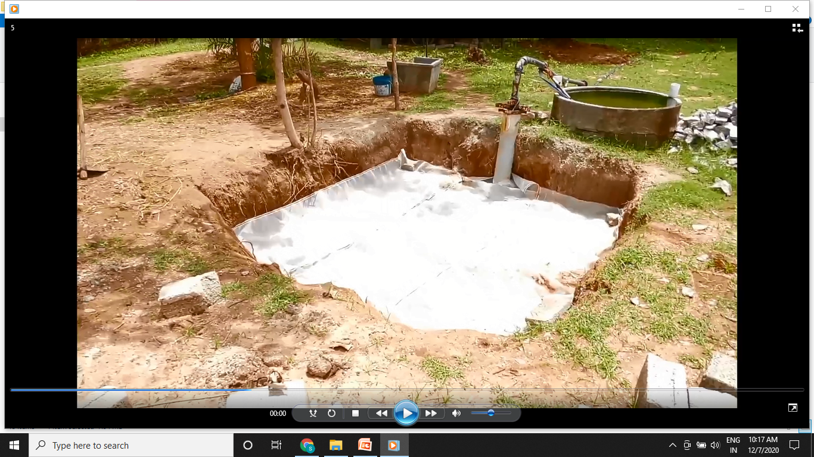
5) Putting a layer of Nylon mesh(To prevent the blockage of pipe by sand):

Slide 12
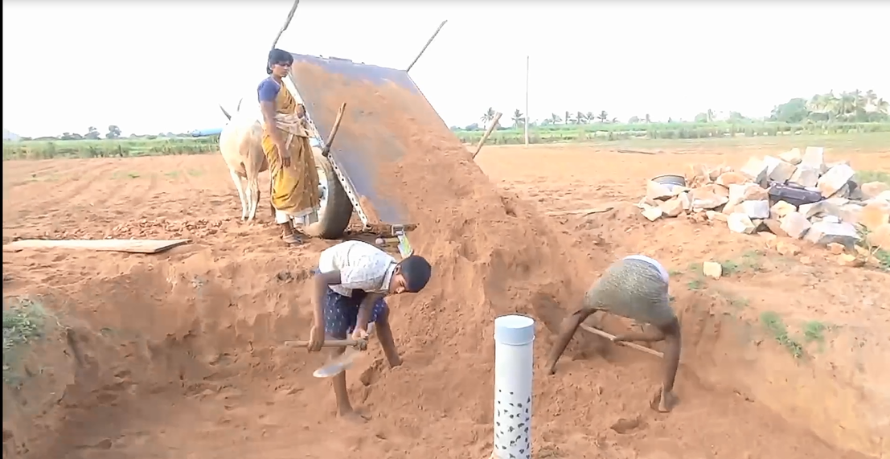
6) Filling the remaining part of the pit by sand:

Slide 13
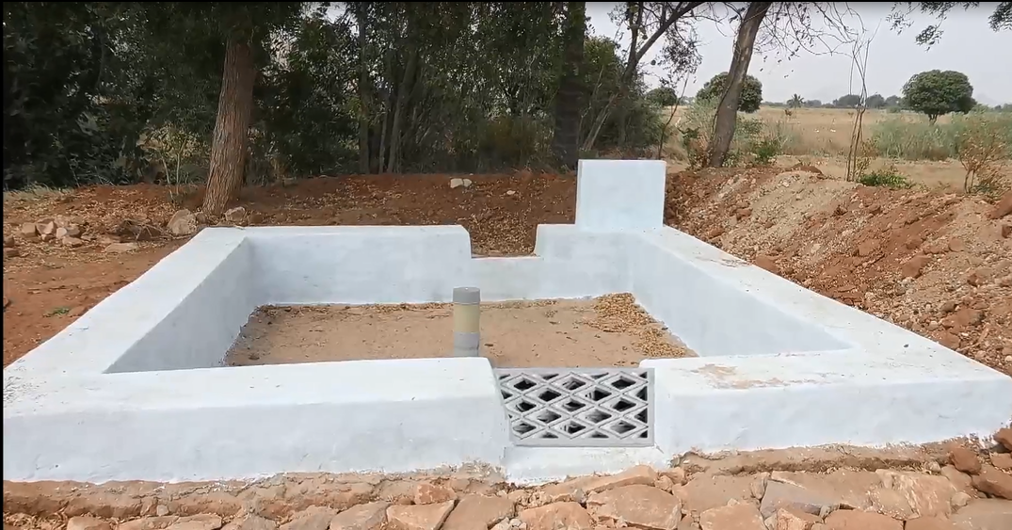
7) Building a protection compound and making a path for water flow towards it:

Slide 14
THANK YOU

